Slide 1

Breaking down the Buzz
Ritika Bhasker

Slide 2
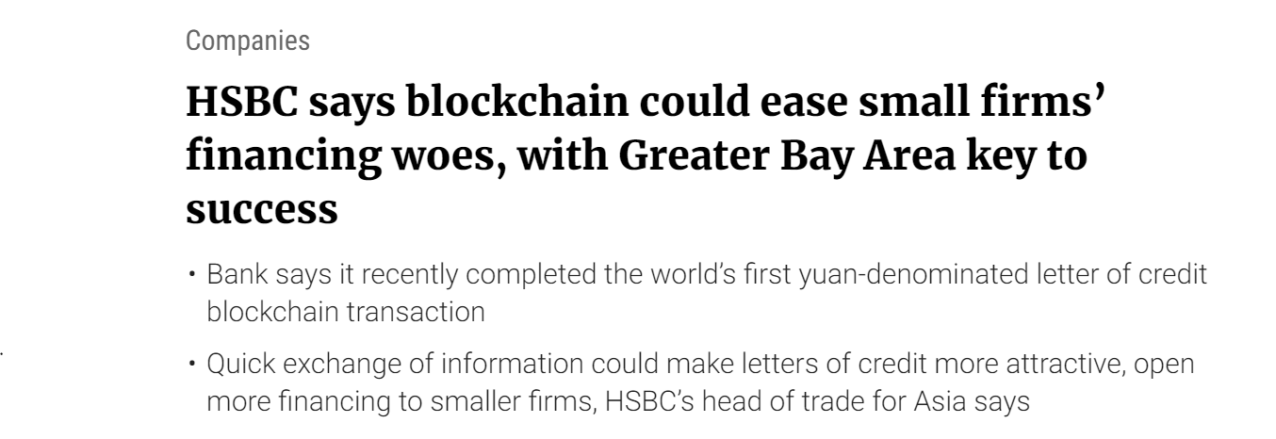
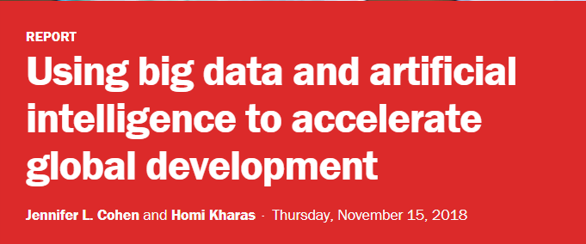
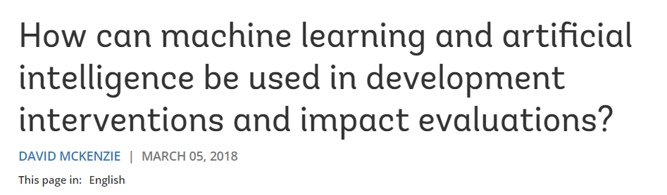
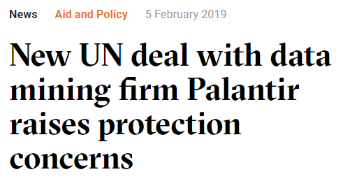

Slide 3
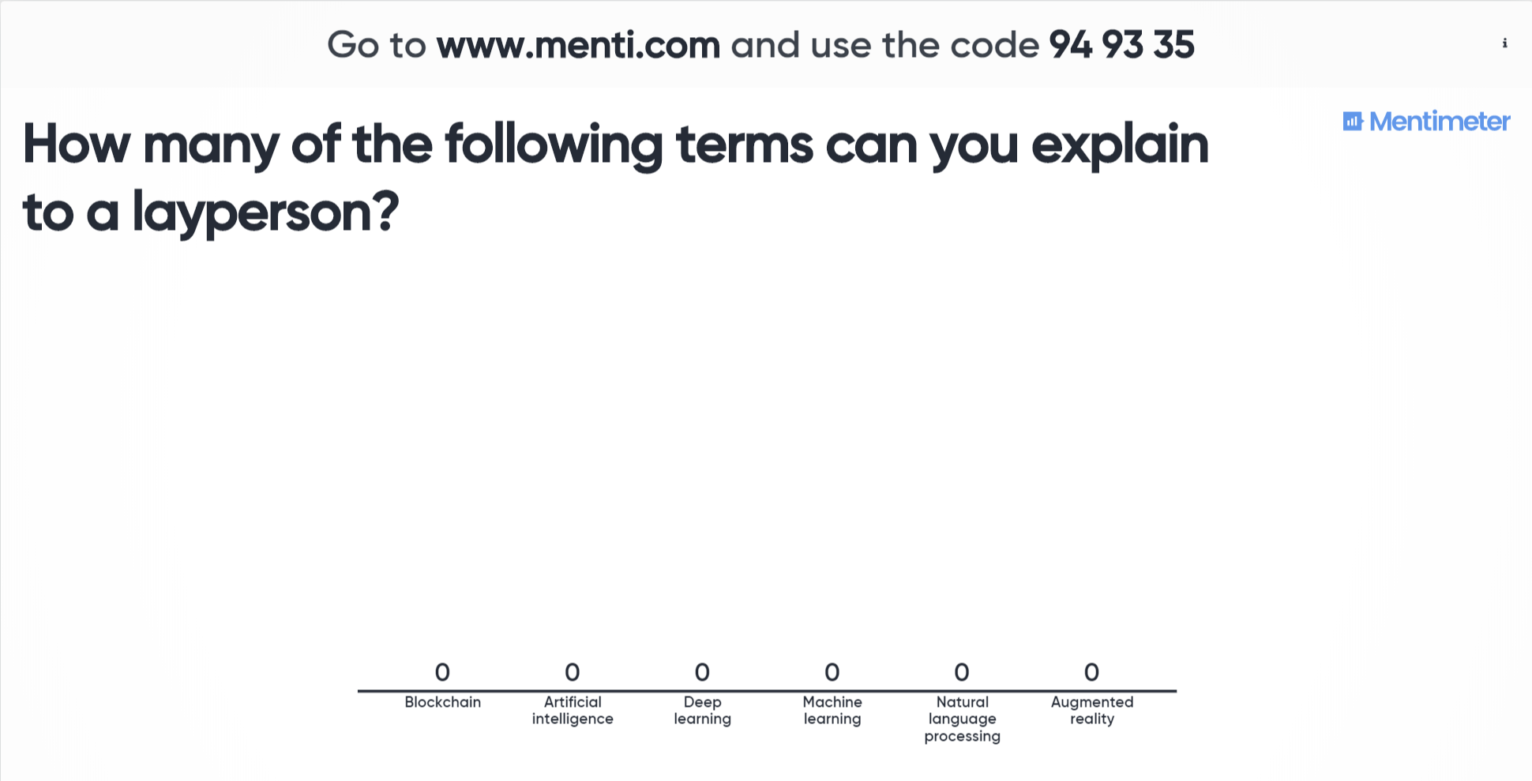

Slide 4
Goals of the session
Define several tech buzzwords we see in the international development community
Discuss existing case studies where these technologies have been applied to international development work
Discuss future use cases/potential uses of these technologies

Slide 5
Artificial intelligence
The ability of a computer (or computer controlled device) to perform tasks that are commonly associated with human intelligence
A simulation of human intelligence by computers, specifically involving processes like learning, reasoning, and self-correction.
Machine learning + deep learning + natural language processing + all of the below

Slide 6
Machine Learning
The process in which we can get computers to learn from data and then make a determination or prediction about something in the world.
Machine learning gets computers to act (make inferences or predictions) without being explicitly programmed to do so.
Machine learning is a part of artificial intelligence: we provide knowledge to computers through data and observations, and this knowledge then helps computers make generalizations and extrapolations about the world.

Slide 7
Machine Learning
Early warning systems (making predictions about potential electoral violence based on a series of criteria/variables)
Satellite imagery to identify possible human rights violations (pattern recognition)
Missing data imputation (gaps in data relating to infrastructure/census data, etc.)

Slide 8
Deep Learning
Deep learning functions exactly like machine learning, except it’s designed to remove human guidance from the process.
Basic machine learning models are constantly adjusted by humans (training and retraining an algorithm). A deep learning model is designed to determine on its own whether a prediction is correct and readjust the model.
Deep learning models learn by example

Slide 9
Deep Learning
IBM Watson for healthcare solutions
Chatbots
Any other examples?

Slide 10
Natural Language Processing
A form of machine learning/artificial intelligence that allows computers to understand and replicate human’s natural language.
The objective of NLP is to read, decipher, understand, and make sense of human languages.

Slide 11
Natural Language Processing
Automated survey processing
Sentiment analysis on social media sites
Analysing and identifying trends in legislative bills or in UN debates and actions
General qualitative analysis

Slide 12
Augmented Reality
A form of virtual reality where the real world is expanded/enhanced with virtual elements
Virtual reality is an experience that is entirely simulated. Augmented reality uses the live/real world and alters the user’s perspective of what is actually happening.

Slide 13
Augmented Reality
Pokemon Go!
Education programs: making certain types of education more interactive and more fun
Real time google translation
Any other examples?

Slide 14
Blockchain
Blockchain is a digital public ledger of permanent, tamper-proof records of data.
Blockchain is a decentralized database.
Blockchain records transactions, encrypts and authenticates them, and makes them visible to all users.
Every blockchain user has the same copy of the blockchain as everyone else.

Slide 15
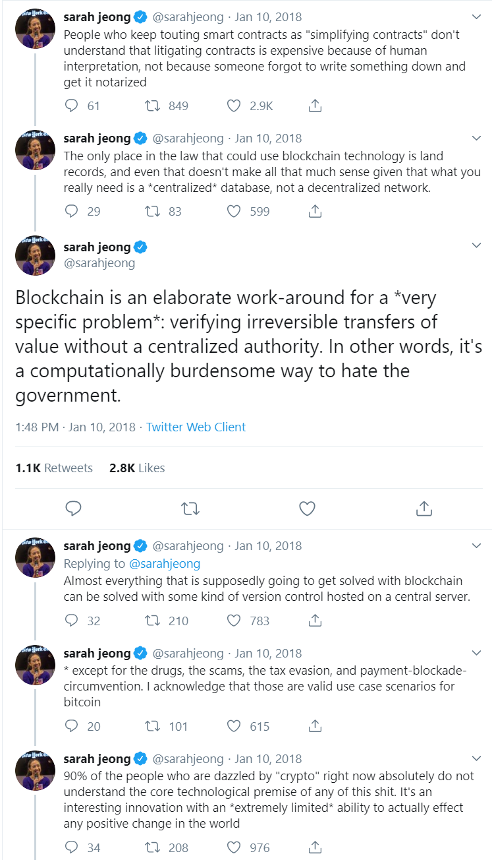

Slide 16
Blockchain
Money transfer and remittances?
Any other examples?

Slide 17
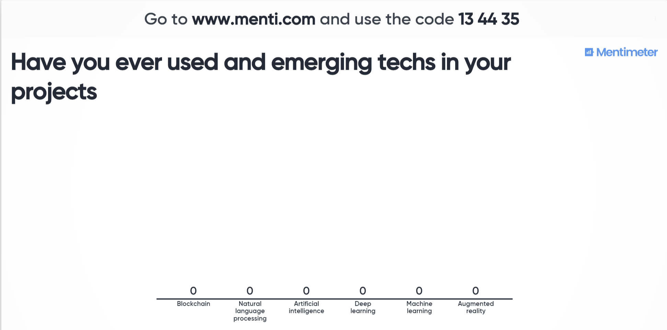

Slide 18
What should we be thinking about when we think of emerging tech?
Machine learning/AI is being used to make critical decisions that affect people’s lives
To make better decisions, everyone is collecting huge amounts of data
Decisions made using algorithms aren’t often apparent, or well communicated, to the public
We’re seeing a growing number of data leaks and people are wary about data collection, data retention, and algorithmic decision making.

Slide 19
What should we be thinking about when we think of emerging tech?
Fairness:
Do our conclusions disproportionately affect certain groups?
Representation:
Does our analysis reinforce existing biases?
Privacy:
What data are we collecting? Is the data we’re collecting and storing secure?
Communication:
Does everyone -- from decision makers to those affected by decisions made -- know and understand what just happened?

Slide 20
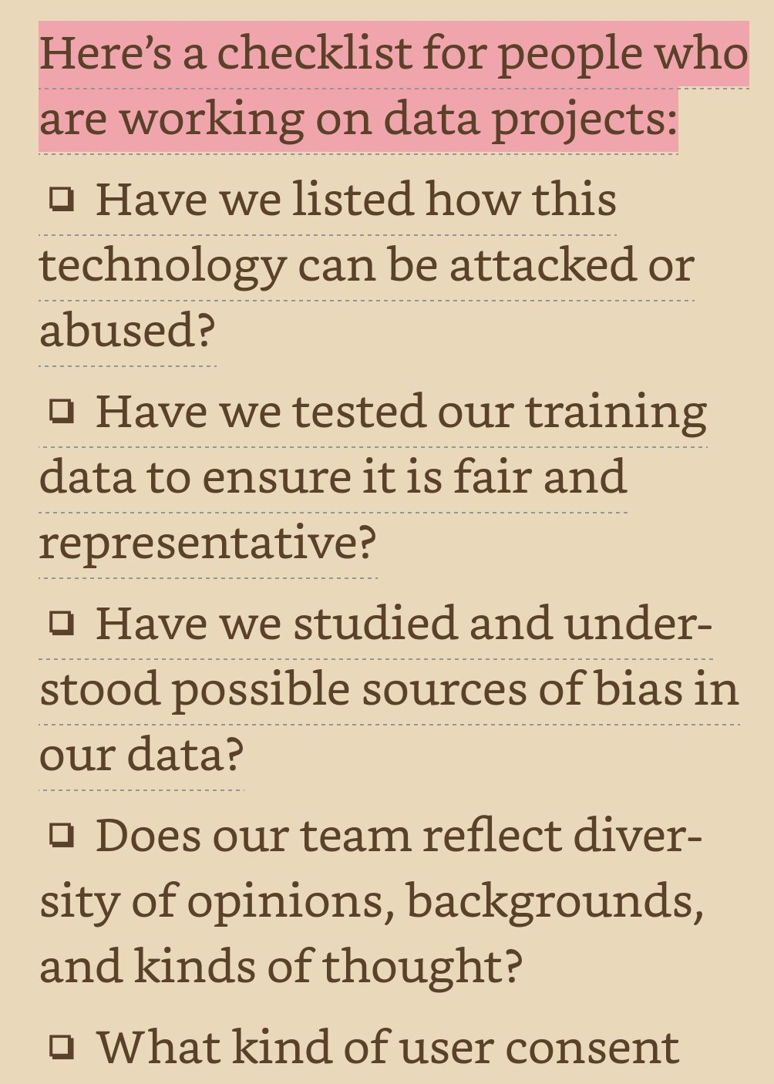
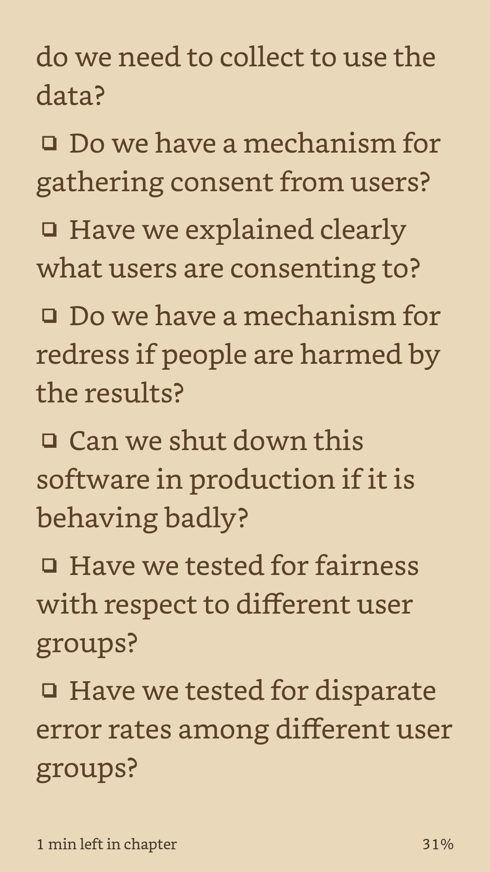
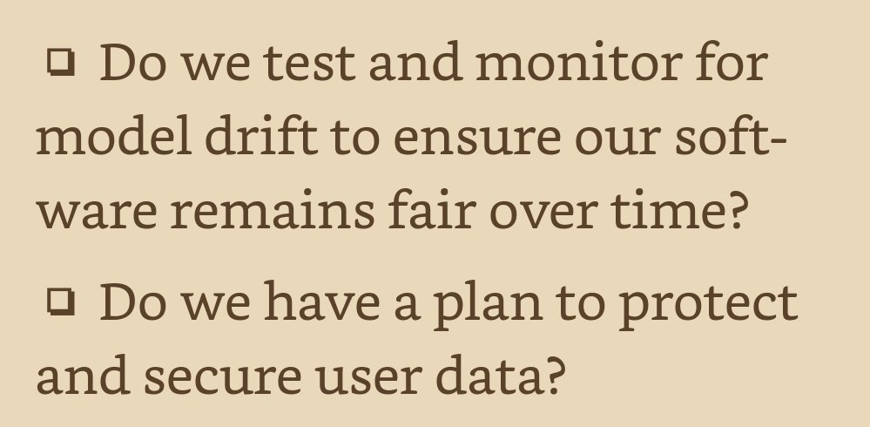


Slide 21
